Slide 1
Let’s make image more realistic
M10702130 JIAN-YU, DAI

Slide 2
Introduction
1

Slide 3

In computer graphics, the goal of photorealistic rendering is to create an image of a 3D scene that is indistinguishable from photograph of same scene. Basically, it is a process of making a digital image in the computer. The digital image is fake but it looks just like real photo. The technic, or the level of this rendering is highly sought after by product design, interior design and architecture so that potential clients may get a feel of the actual product at least at a visual level.

Slide 4
Almost all photorealistic rendering systems are based on the ray-tracing algorithm. Ray tracing is a rendering technique for generating an image by tracing the path of light as pixels in an image plane and simulating the effects of its encounters with virtual objects. But a major disadvantage of ray tracing is that its computation complexity is about square of object number. More object on the scene, much more time needed for rendering.

Slide 5
Ray Tracing Algorithm
2

Slide 6
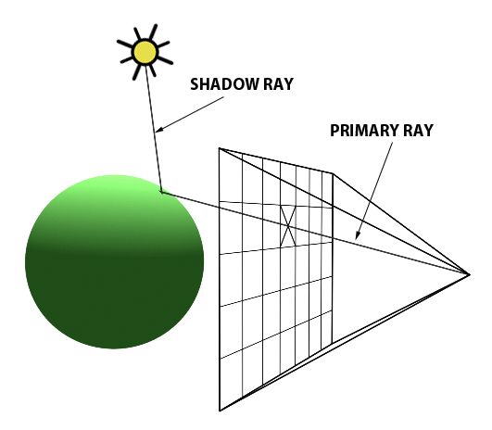
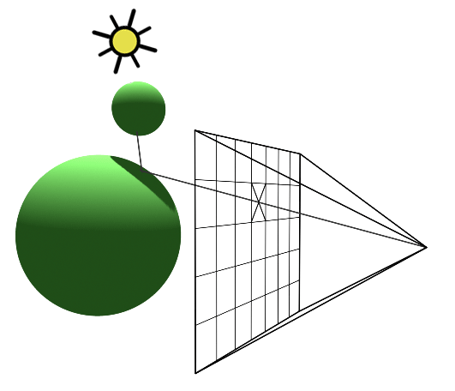
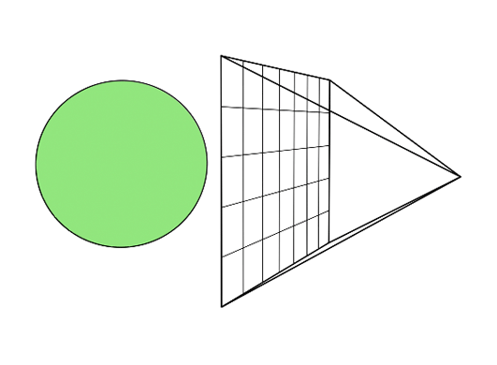
★ The ray tracing algorithm takes an image made of pixels. For each pixel in the image, it shoots a primary ray into the scene.
★ We check every object of the scene to see if it intersects with any of them.
★ In some cases, the primary ray will intersect more than one object. When that happens, we select the object whose intersection point is the closest to the eye.
★ We then shoot a shadow ray from the intersection point to the light. If this particular ray does not intersect an object on its way to the light, the hit point is illuminated. If it does intersect with another object, that object casts a shadow on it.
Notes:
The ray-tracing algorithm takes an image made of pixels. For each pixel in the image, it shoots a primary ray into the scene. The direction of that primary ray is obtained by tracing a line from the eye to the center of that pixel. Once we have that primary ray's direction set, we check every object of the scene to see if it intersects with any of them. In some cases, the primary ray will intersect more than one object. When that happens, we select the object whose intersection point is the closest to the eye. We then shoot a shadow ray from the intersection point to the light (Figure 6, top). If this particular ray does not intersect an object on its way to the light, the hit point is illuminated. If it does intersect with another object, that object casts a shadow on it (figure 2).
If we repeat this operation for every pixel, we obtain a two-dimensional representation of our three-dimensional scene (figure 3).

Slide 7
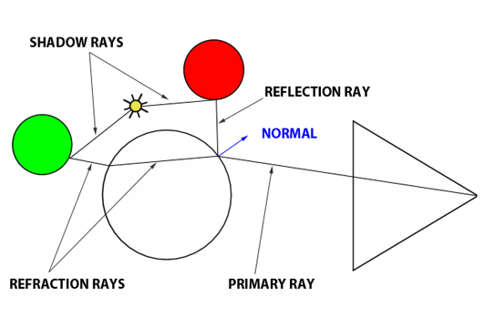
★ The other advantage of ray tracing is that, by extending the idea of ray propagation, we can very easily simulate effects like reflection and refraction, both of which are handy in simulating glass materials or mirror surfaces.
★ Both reflection and refraction directions are based on the normal at point of intersection and the direction of the incoming ray (the primary ray).
★ To compute the refraction direction we also need to specify the index of refraction of the material. When a photon hits an object of a different medium (and thus a different index of refraction), its direction changes.
Notes:
The other advantage of ray-tracing is that, by extending the idea of ray propagation, we can very easily simulate effects like reflection and refraction, both of which are handy in simulating glass materials or mirror surfaces.
In optics, reflection and refraction are well known phenomena. We will take the example of a glass ball, an object which has both refractive and reflective properties. As long as we know the direction of the ray intersecting the ball, it is easy to compute what happens to it. Both reflection and refraction directions are based on the normal at point of intersection and the direction of the incoming ray (the primary ray). To compute the refraction direction we also need to specify the index of refraction of the material. Although we said earlier that rays travel on a straight line, we can visualize refraction as the ray being bent. When a photon hits an object of a different medium (and thus a different index of refraction), its direction changes.
Similarly, we must also be aware of the fact that an object like a glass ball is reflective and refractive at the same time. We need to compute both for a given point on the surface, but how do we mix them together? Fortunately for us, however, there is an equation that calculates precisely how each should be mixed. This equation is know as the Fresnel equation. To remain concise, all we need to know, for now, is that it exists and it will be useful in the future in determining the mixing values.

Slide 8
Algorithm Flowchart
3

Slide 9
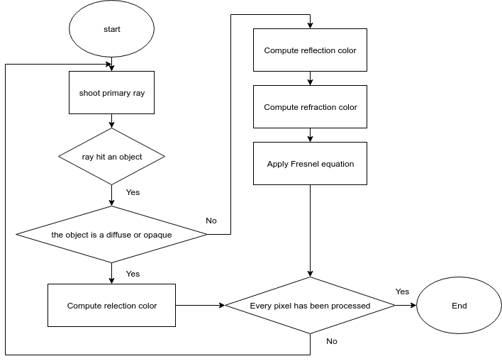
Notes:
We shoot a primary ray from the eye and the closest intersection (if any) with objects in the scene. If the ray hits an object which is not a diffuse or opaque object, we must do extra computational work. To compute the resulting color at that point on, say for example, the glass ball, you need to compute the reflection color and the refraction color and mix them together.
First we compute the reflection direction. For that we need two items: the normal at the point of intersection and the primary ray's direction. Once we obtain the reflection direction, we shoot a new ray in that direction.We find out how much light reaches that point on the red sphere by shooting a shadow ray to the light. That obtains a color (black if it is shadowed) which is then multiplied by the light intensity and returned to the glass ball's surface.
Now we do the same for the refraction. To compute the transmission direction we need the normal at the hit point, the primary ray direction, and the refractive index of the material (in this example it may be something like 1.5 for glass material). With the new direction computed, the refractive ray continues on its course to the other side of the glass ball. There again, because it changes medium, the ray is refracted one more time. As you can see in the adjacent image, the direction of the ray changes when the ray enters and leaves the glass object. Refraction takes place every time there's a change of medium and that two media, the one the ray exits from and the one it gets in, have a different index of refraction. Refraction has for effect to bend the ray slightly.
Lastly, we compute the Fresnel equation. We need the refractive index of the glass ball, the angle between the primary ray, and the normal at the hit point. Using a dot product, the Fresnel equation returns the two mixing values.

Slide 10
Parallelism
4

Slide 11
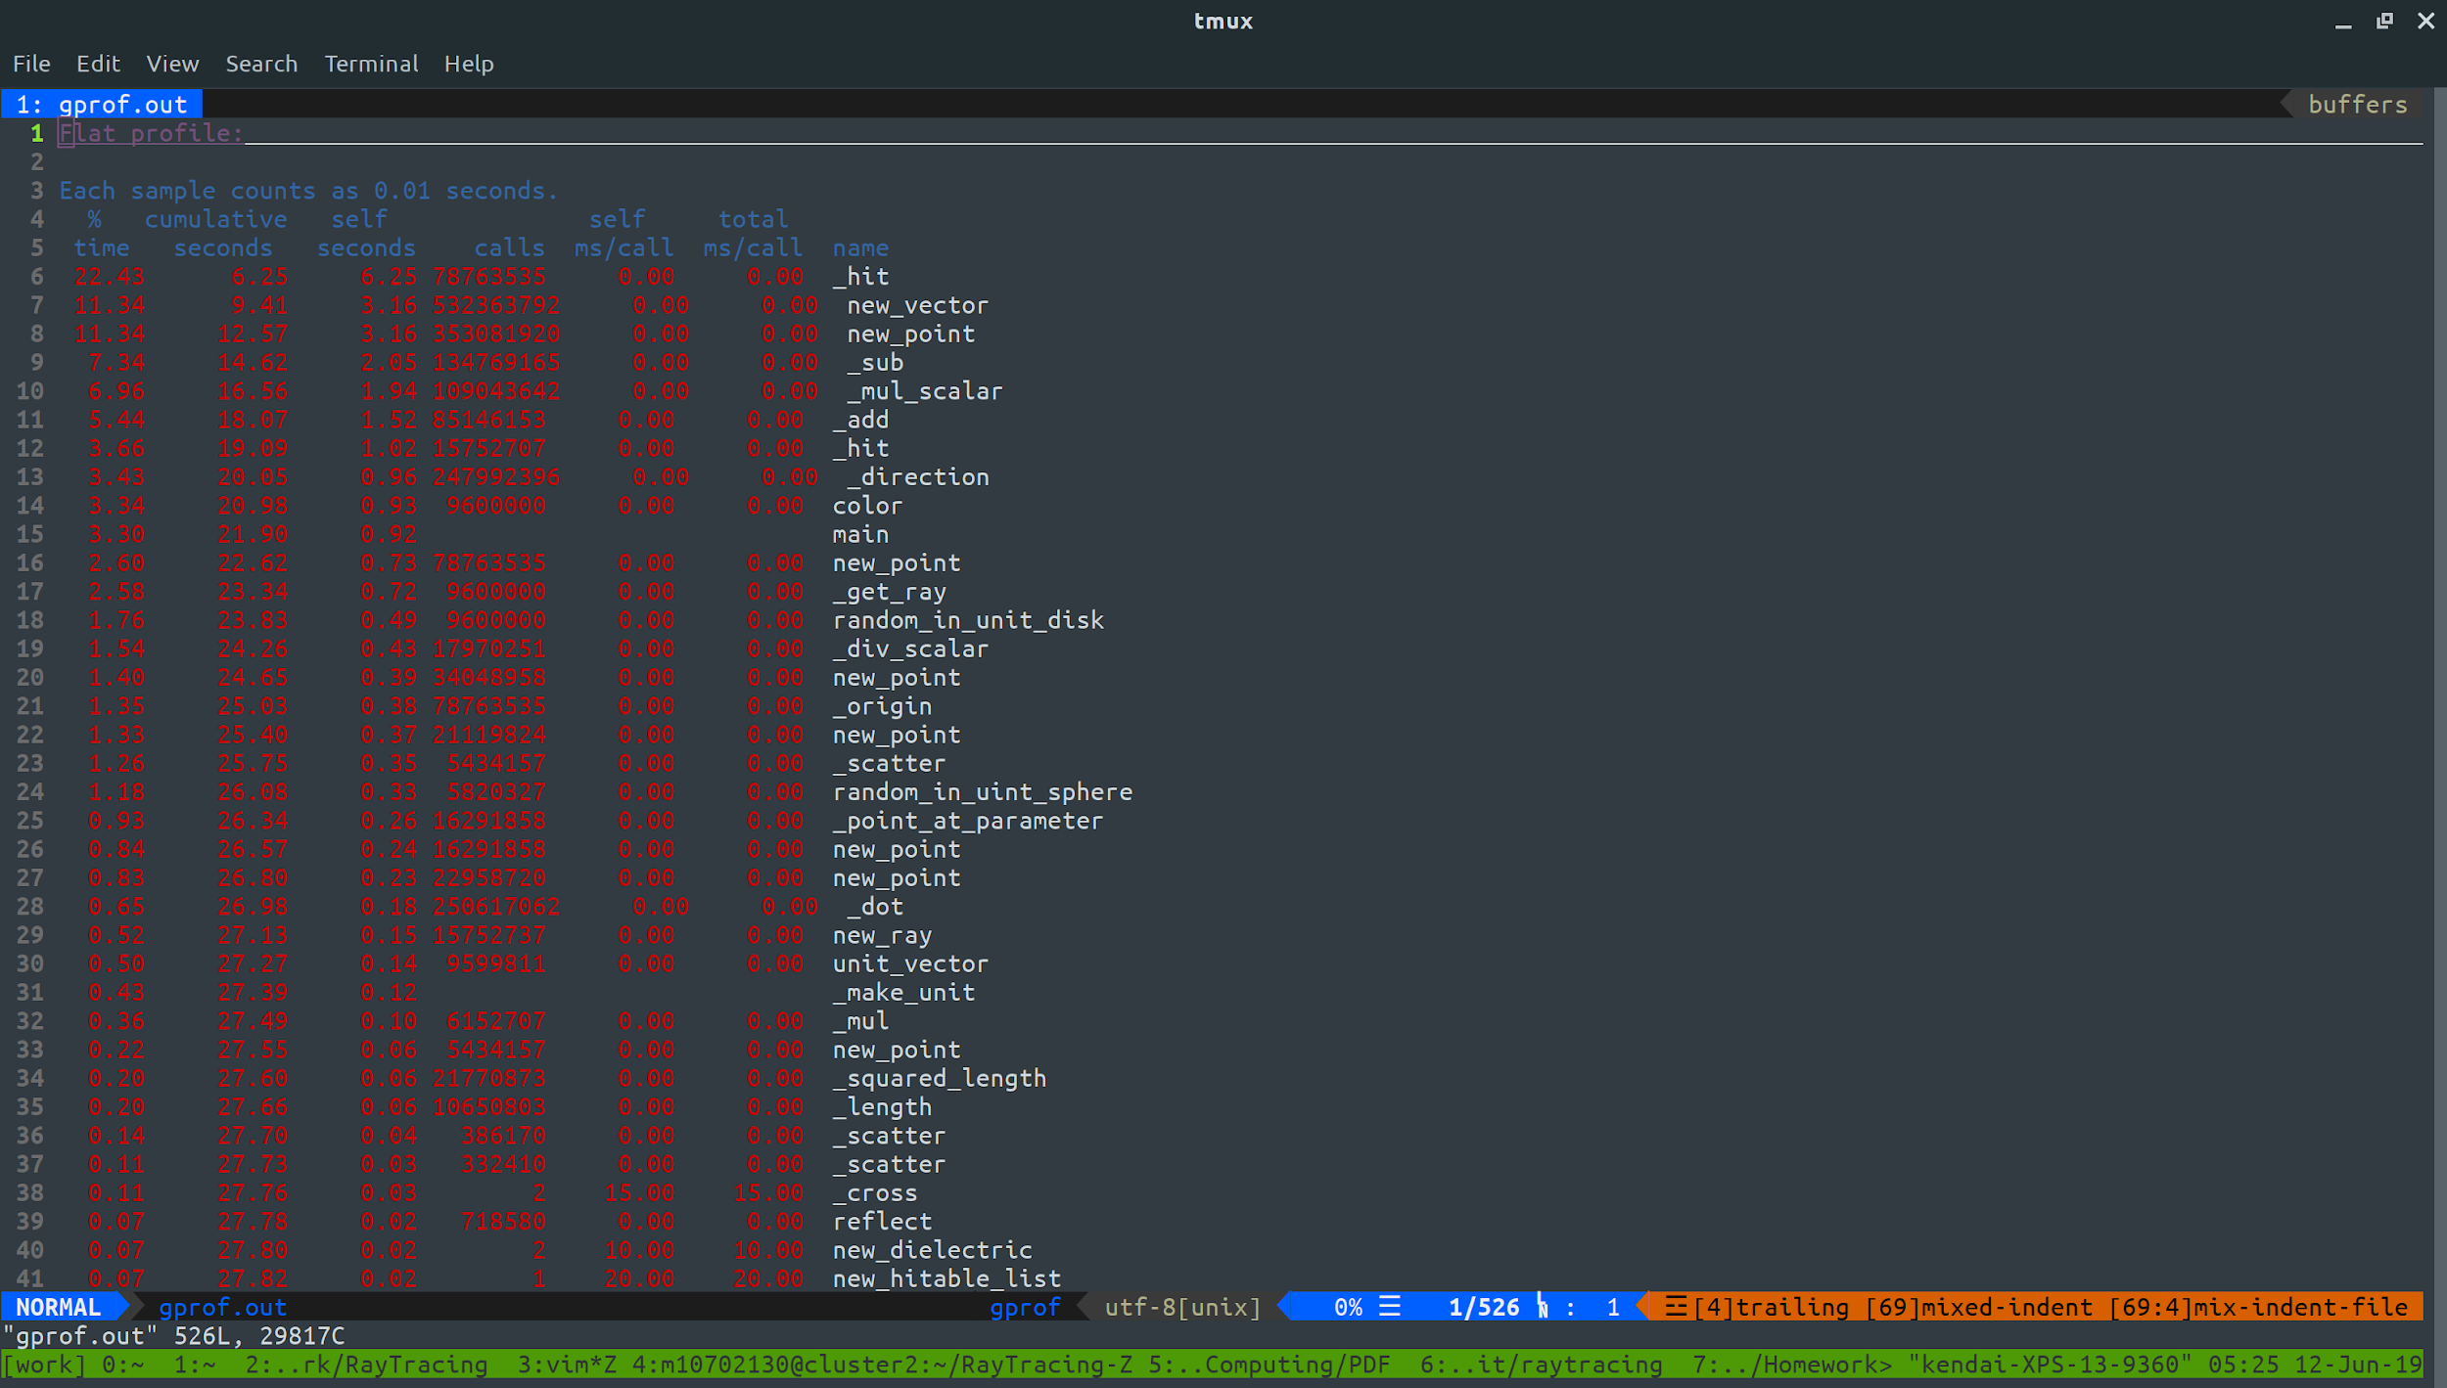
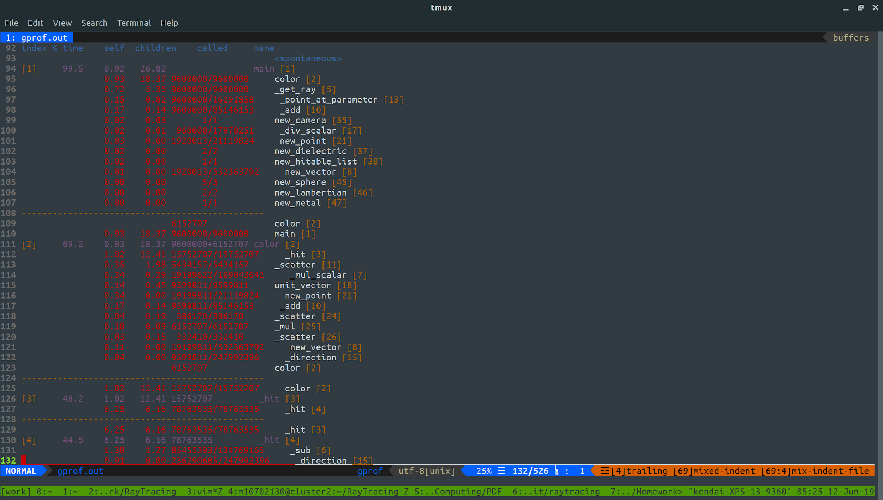
★ In this project, I use OpenMP to make some part of program to execute parallel. To know where the part is, I use GNU profiler (gprof) to find out the bottleneck of the program.

Slide 12
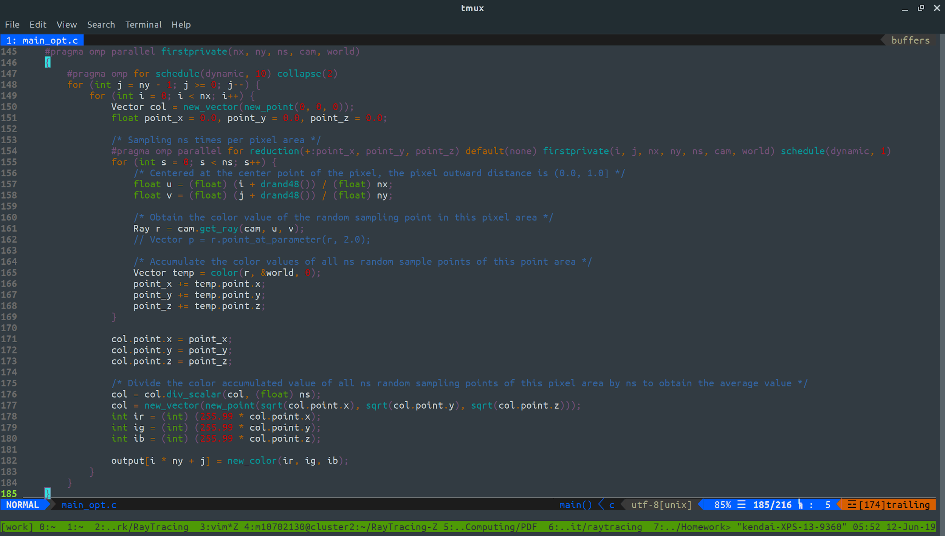
★

Slide 13
Comparison
5

Slide 14
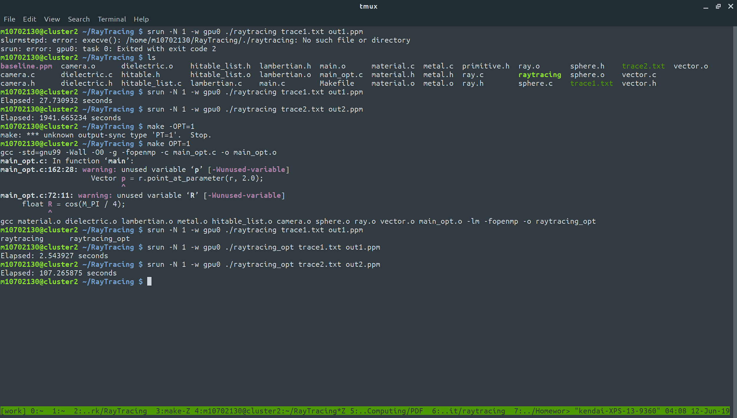
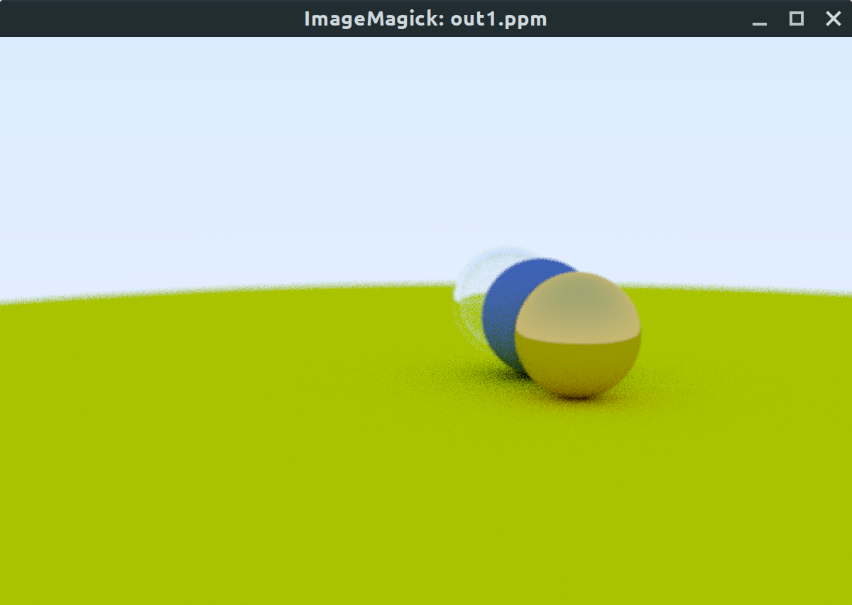
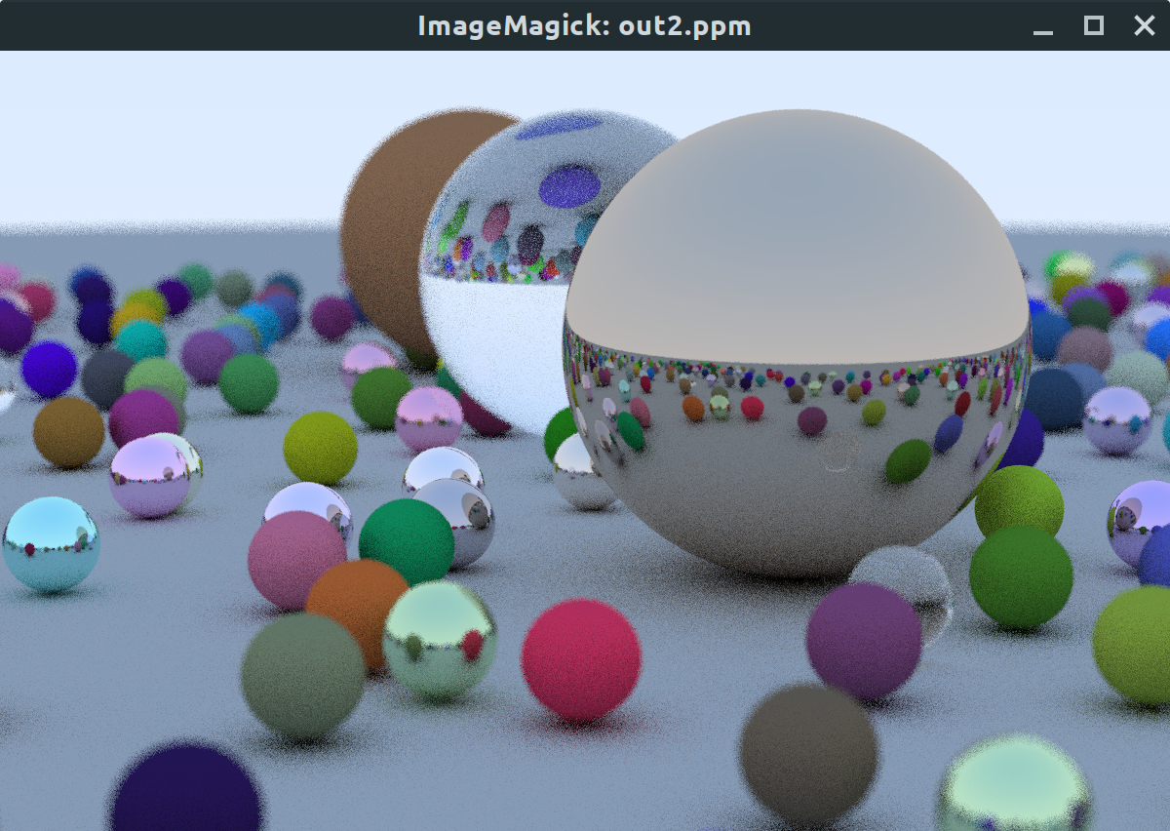
★ trace1.txt and out1.ppm
The size of the image is 1200x800 and the image contains 5 spheres. Speedup 1108%
★ trace2.txt and out2.ppm
The size of the image is 1200x800 and
the image contains 485 spheres. Speedup 1809.6%

Slide 15
Although the actual output and expected output look the same, but actually some pixels are different. For the image no jaggies along edges, we need to make the edge pixels are a blend of some foreground and some background. We can implement by averaging a bunch of samples inside each pixel.
So we need is a random number generator that returns real random numbers. For a given pixel we have several samples within that pixel and send rays through each of the samples. The colors of these rays are then averaged.
Here is the problem. When the thread gets the random number in different order, the number is different, so the result are also different. But it is not a big deal, because these two images still look the same.

Slide 16
References
[1] http://www.scratchapixel.com/lessons/3d-basic-rendering/introduction-to-ray-tracing/how-does-it-work
[2] http://www.pbr-book.org/3ed-2018/Introduction/Photorealistic_Rendering_and_the_Ray-Tracing_Algorithm.html
[3] https://blog.csdn.net/libing_zeng/article/details/72598060
[4] http://www.photoneray.com/raytracer_01/
[5] An Improved Illumination Model for Shaded Display, Turner Whitted

Slide 17
Thanks!
Any questions?

